Slide 1
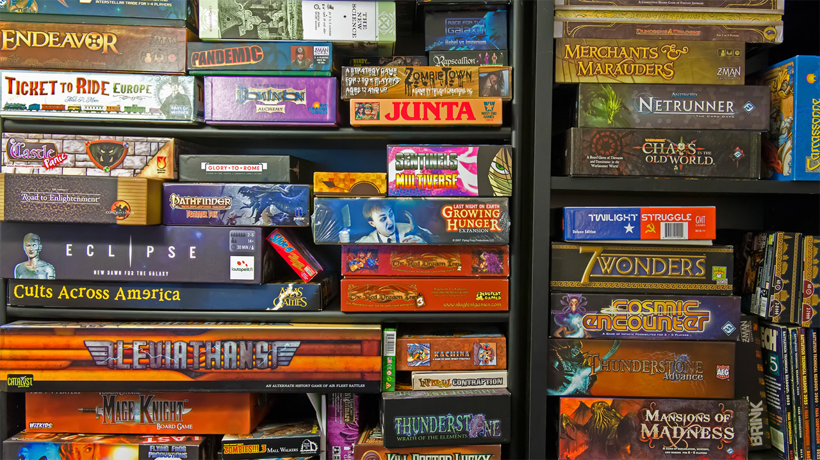
Mancala
By: Jhobani Torres

Slide 2
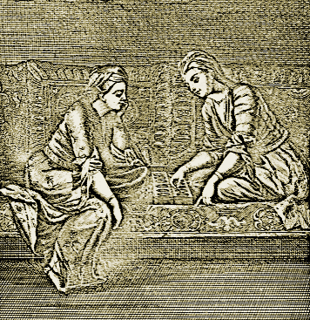
Mancala’s Origins
The earliest traces of the game Mancala where found in Eritrea and in Ethiopia dated around the 6th or 7th Century.

Slide 3
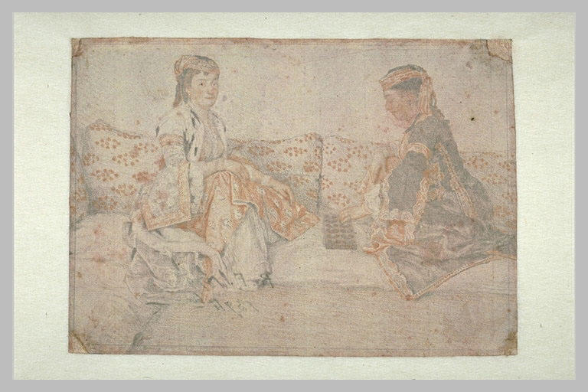
Proof the Game Existed
The earliest evidence of the game where found in Matara and Yeha in the form of a pottery board and rock cuts.
It was also mentioned in Giyorgis of Segla in Mysteries of Heaven and Earth and was recorded as being played by English merchants in England as early as the 17th century.

Slide 4
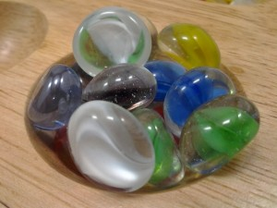
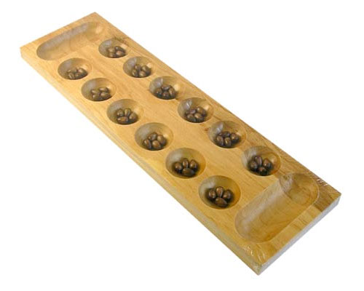
Game Piece Info
The game pieces look like clear pebbles and the board is a regular board with holes in it to hold the pieces.

Slide 5
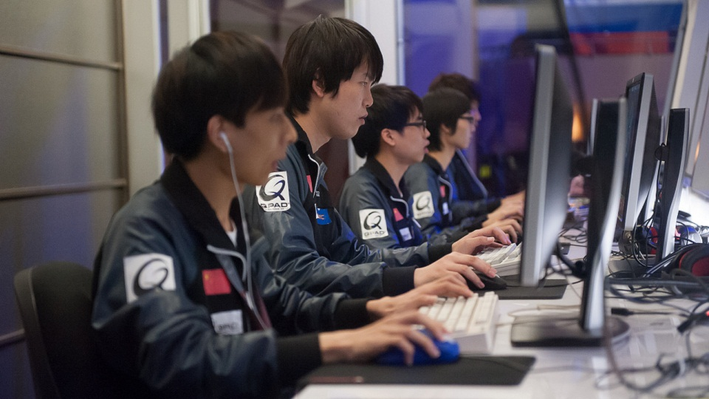
Player Requirements
The number of players required to play Mancala are Two Players or more.

Slide 6
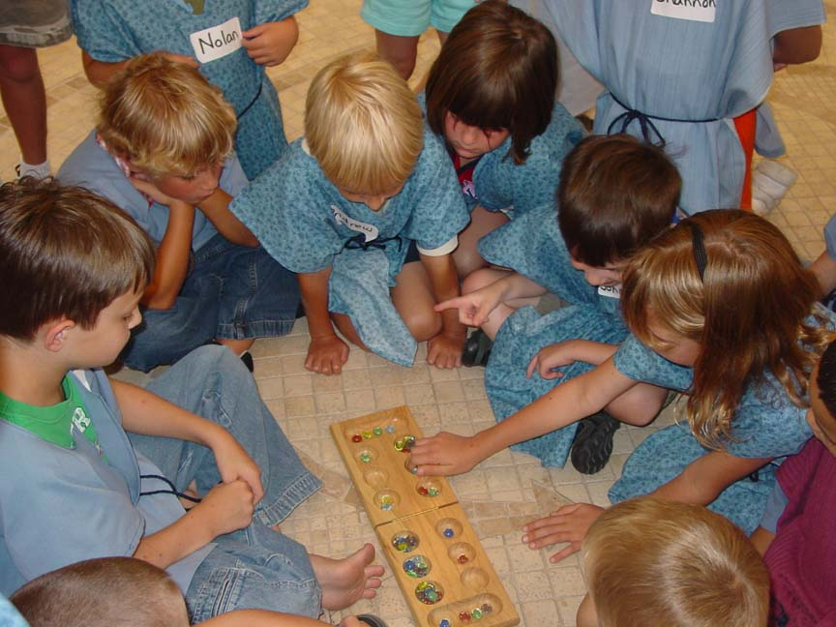
How the Game is played
The actual rules of the game do exist and the game is played by setting four stones in each of the holes except for the long ones. You decide who goes first and the first person will grab all the stones in one hole and drops them one by one in succeeding holes and may place their stones in their long hole and can put it in the opponents holes except for the long one. This keeps on going until there are no more stones in one’s hand and then its the opponents turn. The game is over when one person has no more stones left on their side. After counting the stones on each side, the person with the most stones in their long hole wins.

Slide 7
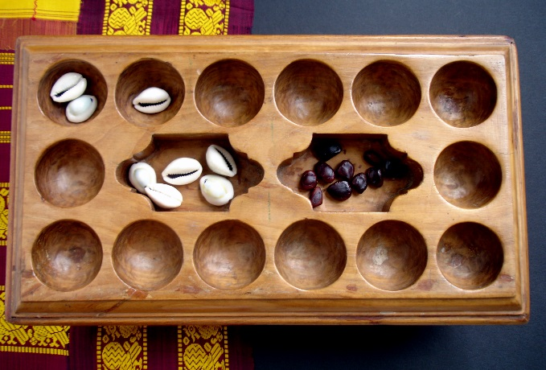
How the Game is played Cont.
If, when dropping stones in holes, you drop a stone into your long hole, and that is the last stone in your hand, then you get to go again. If, when dropping stones into holes, you drop a stone into a hole that was previously empty, and the hole is on your side, and that was the last stone in your hand, you take all of the stones in the hole directly above, and place them into your long hole.

Slide 8
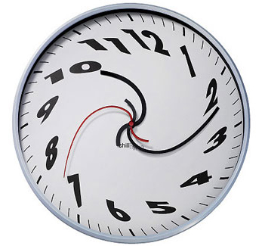
General Info
The amount of time this game usually takes to play is about 15 minutes.

Slide 9
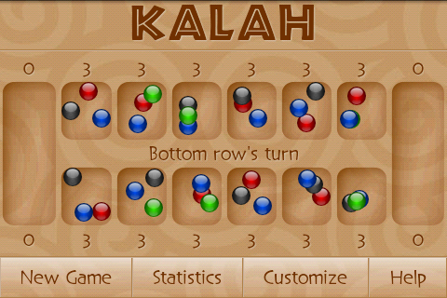
Other Versions
Mancala has been very popular in how it has sprung very different versions of itself such as Bao la Kiswahili, Congkak, Kalah, Oware, and Toguz Kumalak.

Slide 10
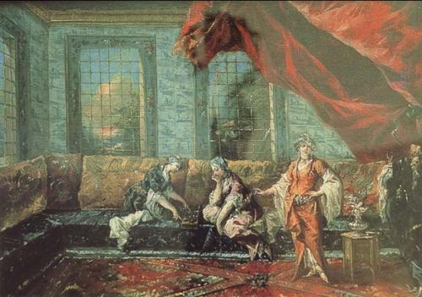
More Info on the Game
The game of mancala has been known in many regions as Ban-Ban, Ouril, Qarqis, Bohnenspiel, and Mandoli.

Slide 11
The End

